Slide 1
R scripts for initial data processing during analysis of multiplex serologies

Slide 2
Workflow – Script I
Output:
Merged .XLSX worksheet containing:
Summarized beadcounts
Summarized MFI values
Allocation data
Measurements with some exclusion criteria (low/high beadcount, empty wells, missing beads)
.csv files from Luminex
Allocation plan
Bead list
R Script

Slide 3
Workflow – Script II
Output:
Net MFI values for sera and control samples (min: negative or 1)
Warnings for GST, row mean, and carry-over from Script I
Merged output from previous script
R Script

Slide 4
Possible Uses and Limitations
Feasible situations:
Combine .csv files from
several study days
Include multiple remeasurements
Use “,“ or “.“ for decimal numbers
➔ rounded output
Input: old & new excel versions (.xlsx, .xls)
Restrictions:
Nomenclatures & requirements for input files (.csv, bead file, allocation plan)

Slide 5
Essential preconditions – .csv files
Nomenclature of .csv files:
… Luminex [A, B, C, D, E] Platte [1-999].csv (normal)
… Luminex [A, B, C, D, E] Platte [1-999] R[999].csv (remeasurement)
E.g.:
UKB_IDBP_291015 Nicole Luminex A Platte 1
UKB_IDBP_291015 Nicole Luminex A Platte 1 R1
For remeasurements, more than one can be provided for each well, but these will be processed in ascending order. Only the last remeasurement will be used.

Slide 6
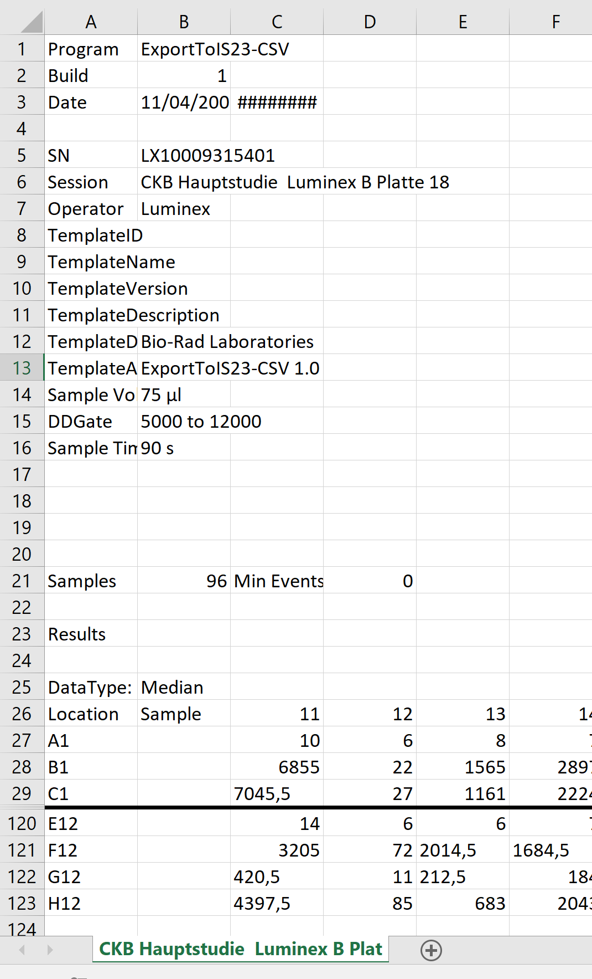
Essential preconditions - .csv files
Samples: Must equal the number of rows in the file, not the actual number of measurements
Important for stopping measurements
Concatenating files!

Slide 7
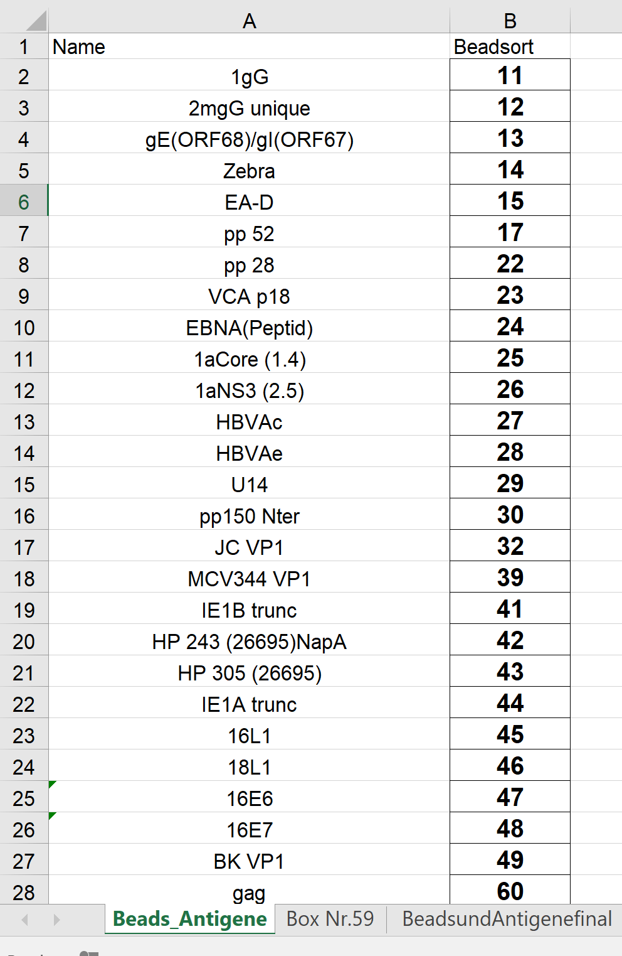
Essential preconditions – Bead list
Column headers: “Name“ and “Beadsort“
Bead types: only numbers
Missing antigens will not be processed
Sheet name: Not specified, but no special characters or umlauts.

Slide 8
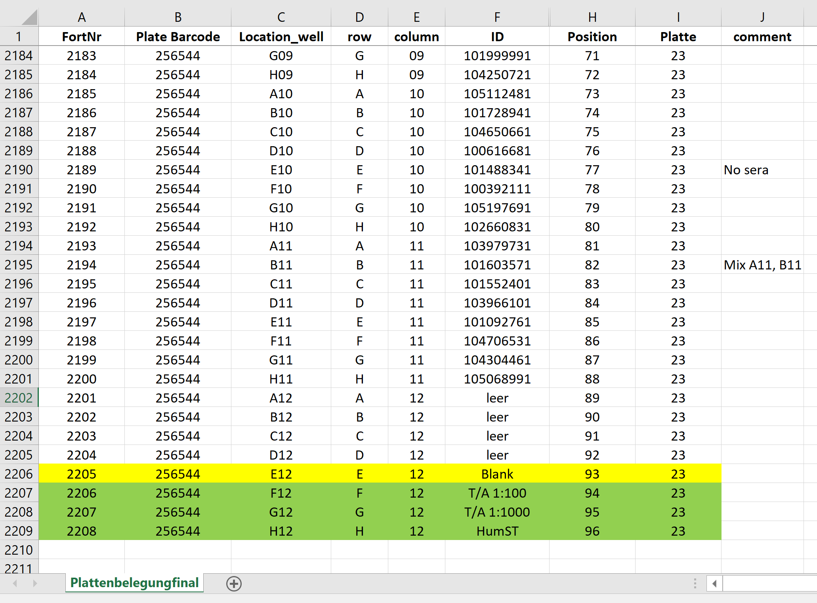
Essential preconditions – Allocation plan
Column headers: “FortNr“ and “ID“
“FortNr“ must be unique
Column headers: “Comment“
Typically contains exclusion criteria
Multiple columns allowed:
Eg. “Comment“, “Prev_comment“ “Old_Comments“, “Comment from study“
Controls
Empty control must be named as “Blank“, or it is excluded
Dilutions included, if used
Sheet name: Not specified, but no special characters or umlauts.

Slide 9
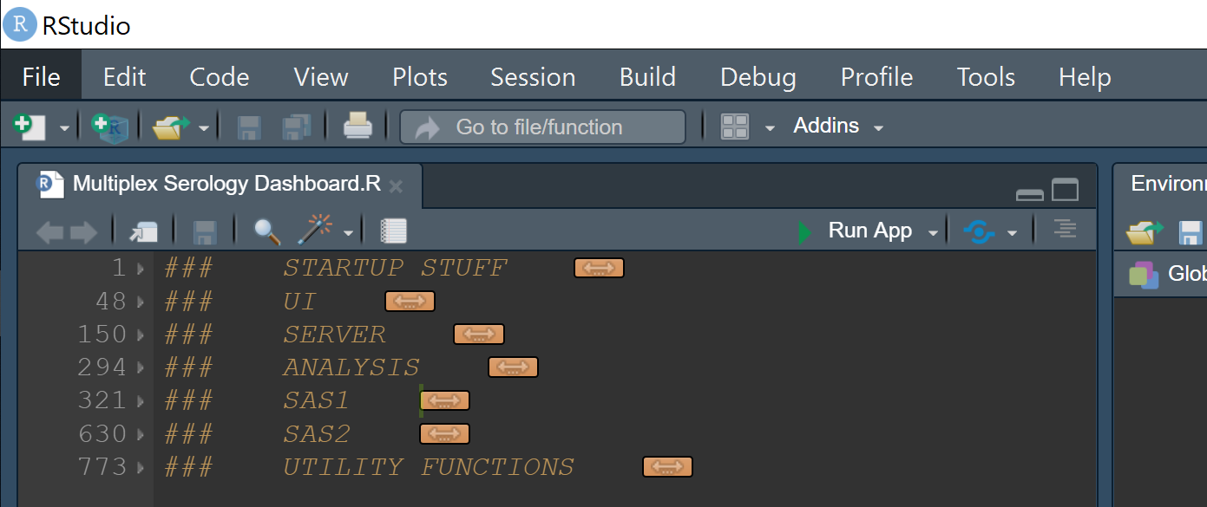
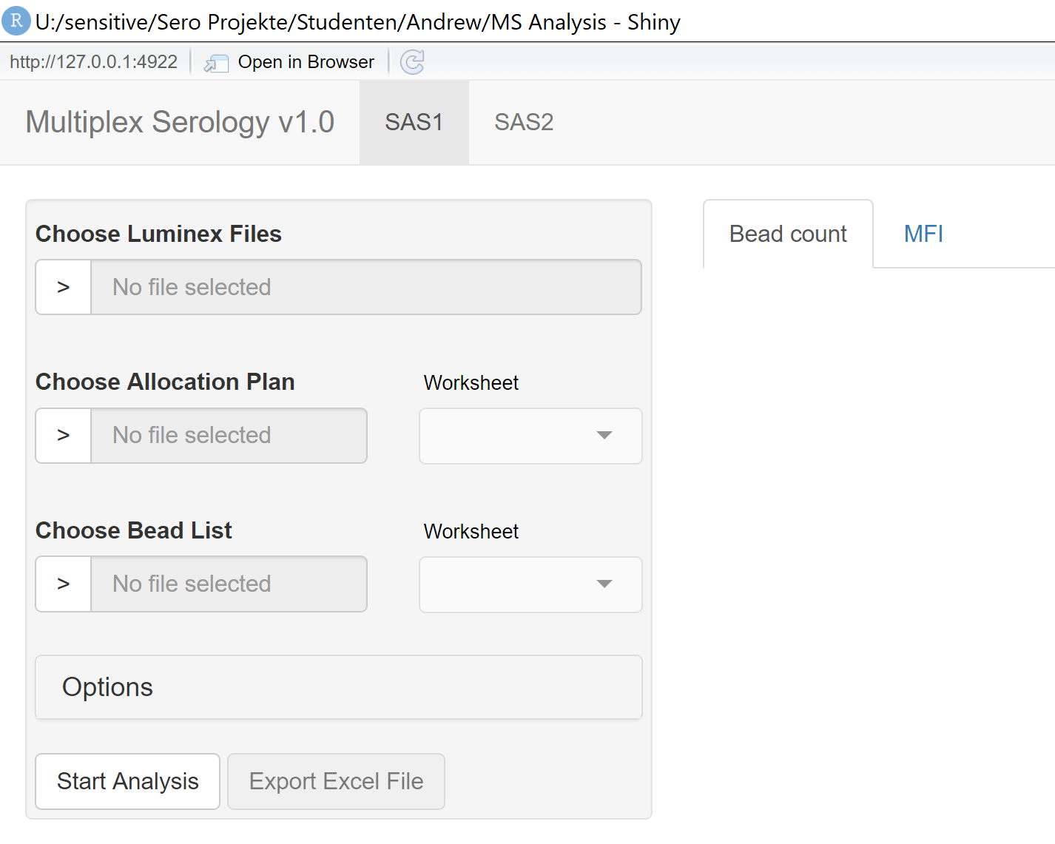
Procedure – Script I
Open the script file in R, then click “Run App“
The graphical user interface (GUI) will appear

Slide 10
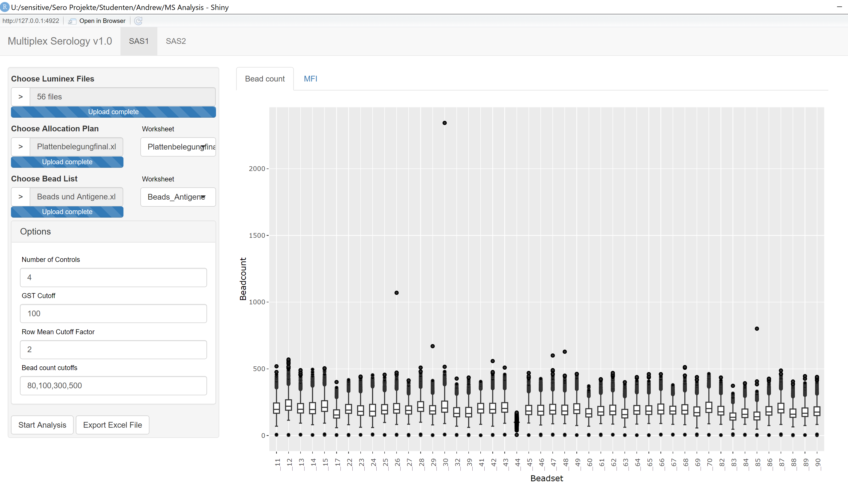
Procedure – Script I
Import your desired files, set any necessary options, then “Start Analysis“
Graphs for bead count and MFI will be generated, and data can be exported by “Export Excel File“

Slide 11
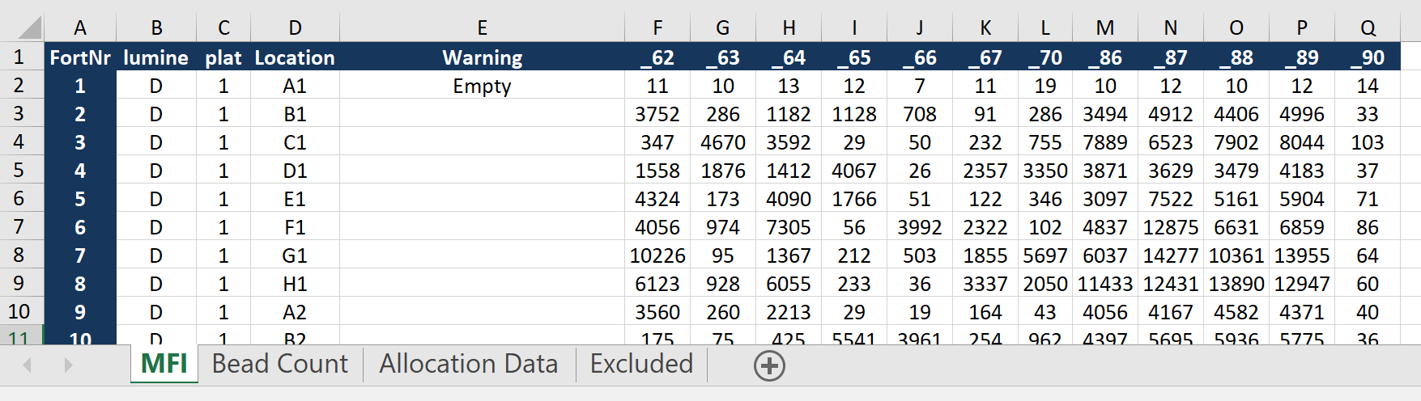
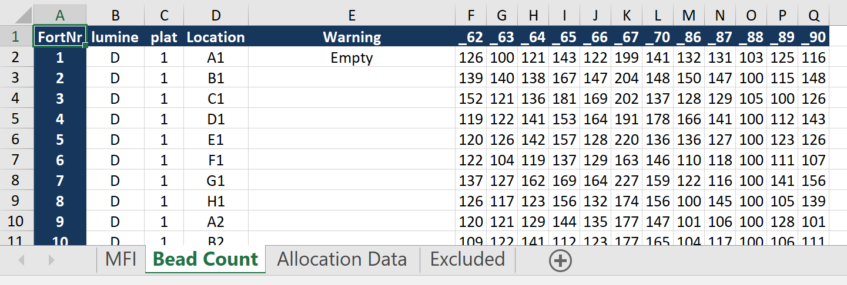
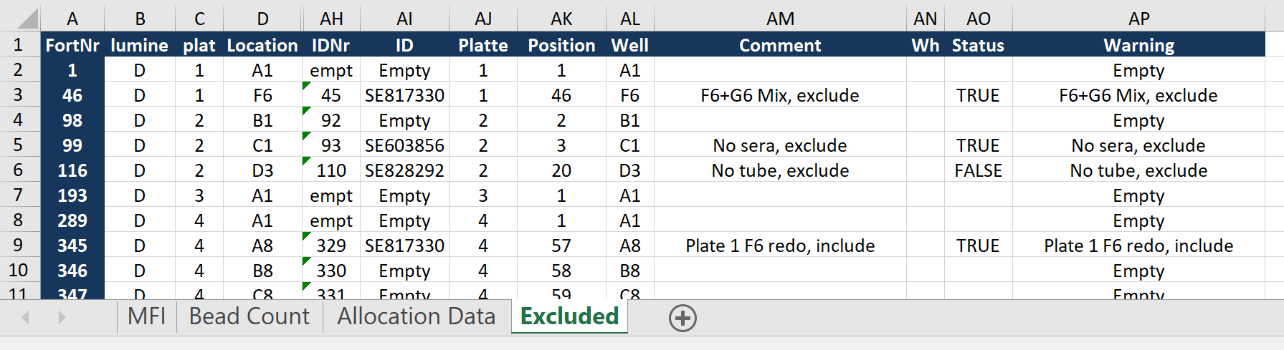
Output – Merged file
MFI and Beadcount
Separate worksheets within the same Excel file
Excluded
Replaces the warning file
All measurements contained in this worksheet will not be used in the next script

Slide 12
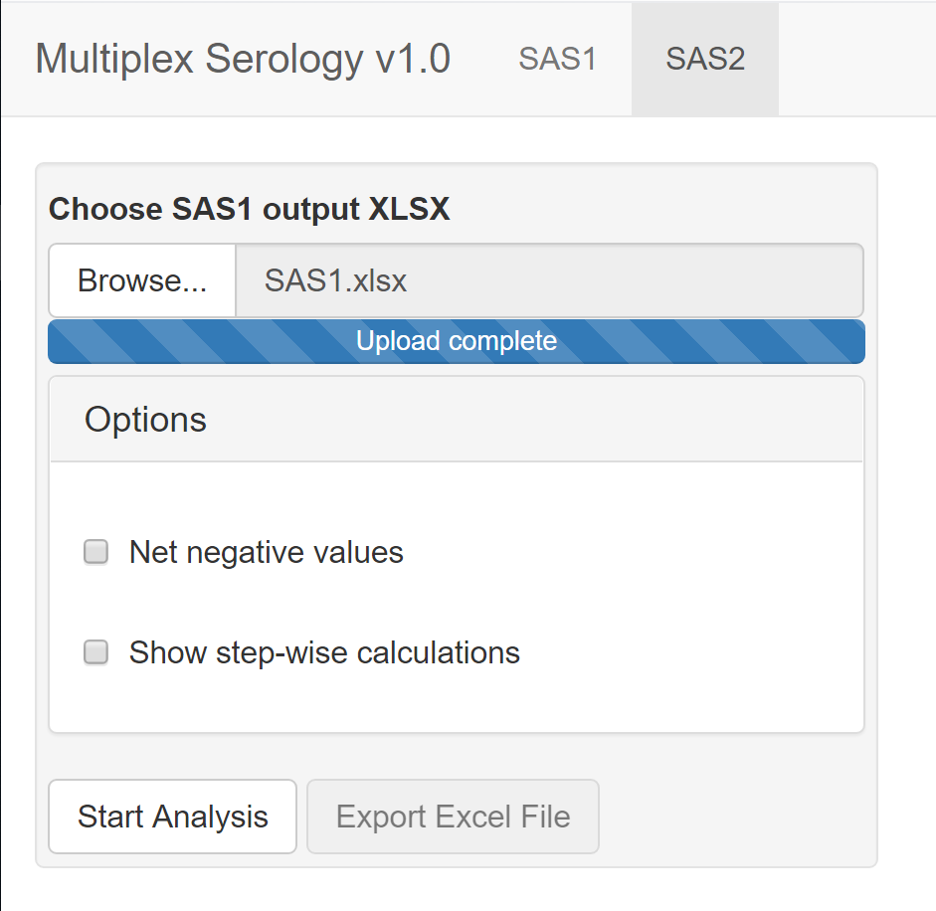
Procedure – Script II
Switch to tab SAS2, import your desired files, set any necessary options, then “Start Analysis“

Slide 13
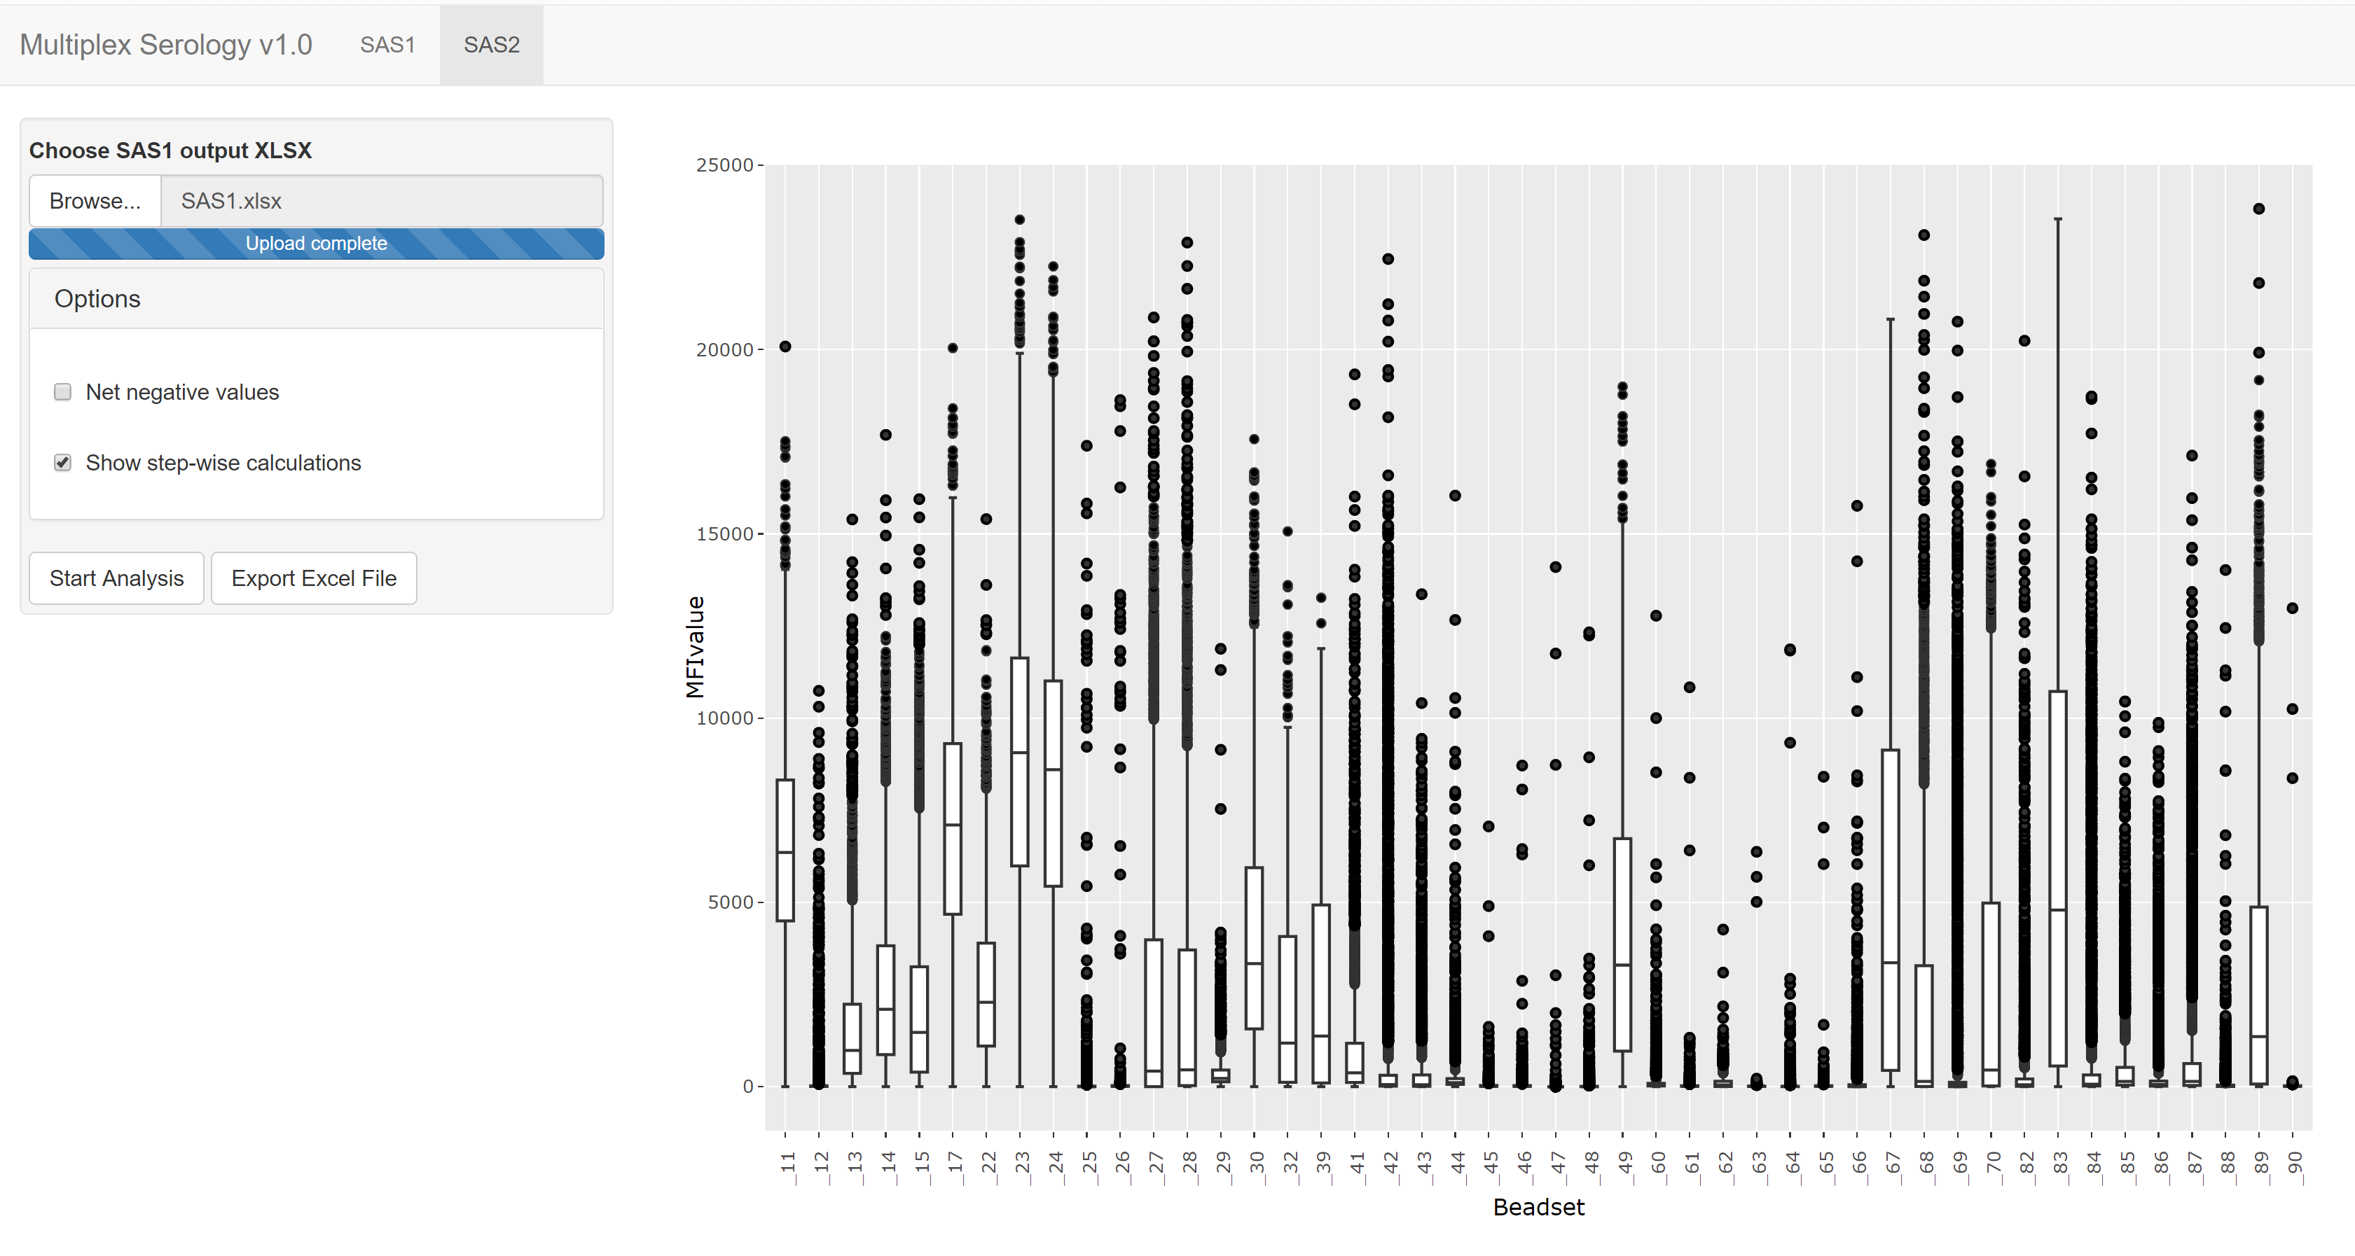
Procedure – Script I
Graph for net MFI will be generated, and data can be exported by “Export Excel File“

Slide 14
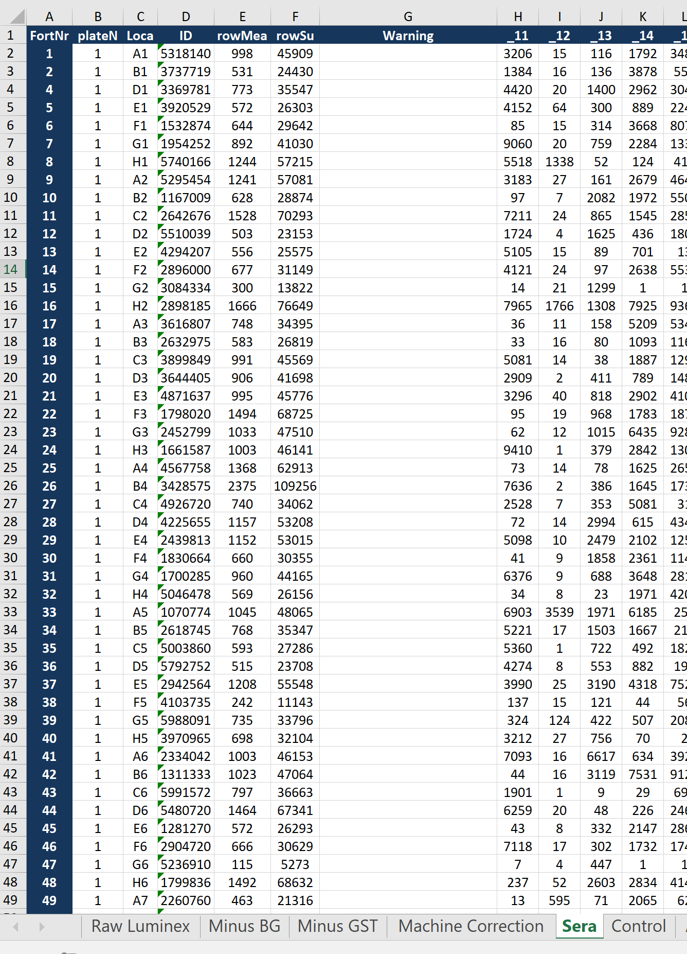
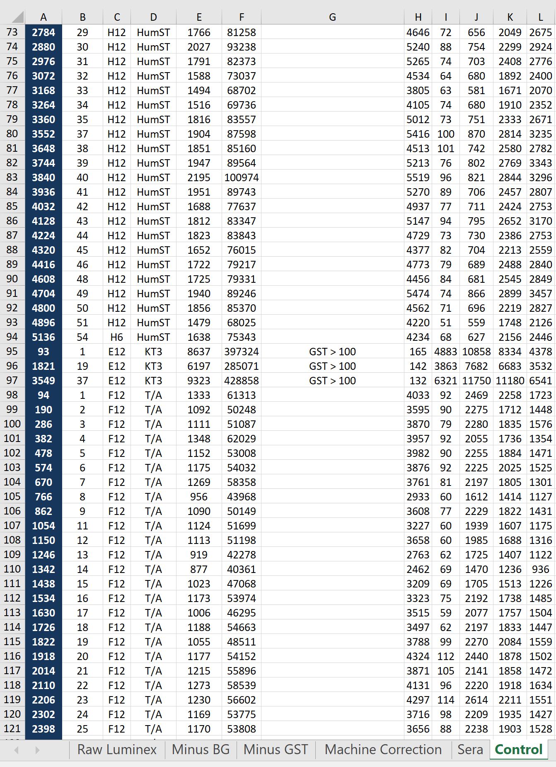
Output – Net MFIs
Net MFIs are shown for the sera and controls in seperate worksheets. Either net values or net negative MFI can be shown.
Warnings from the allocation file, Script I and new Script II errors are shown.
Step-by-step calculations can also shown in seperate sheets

Slide 15
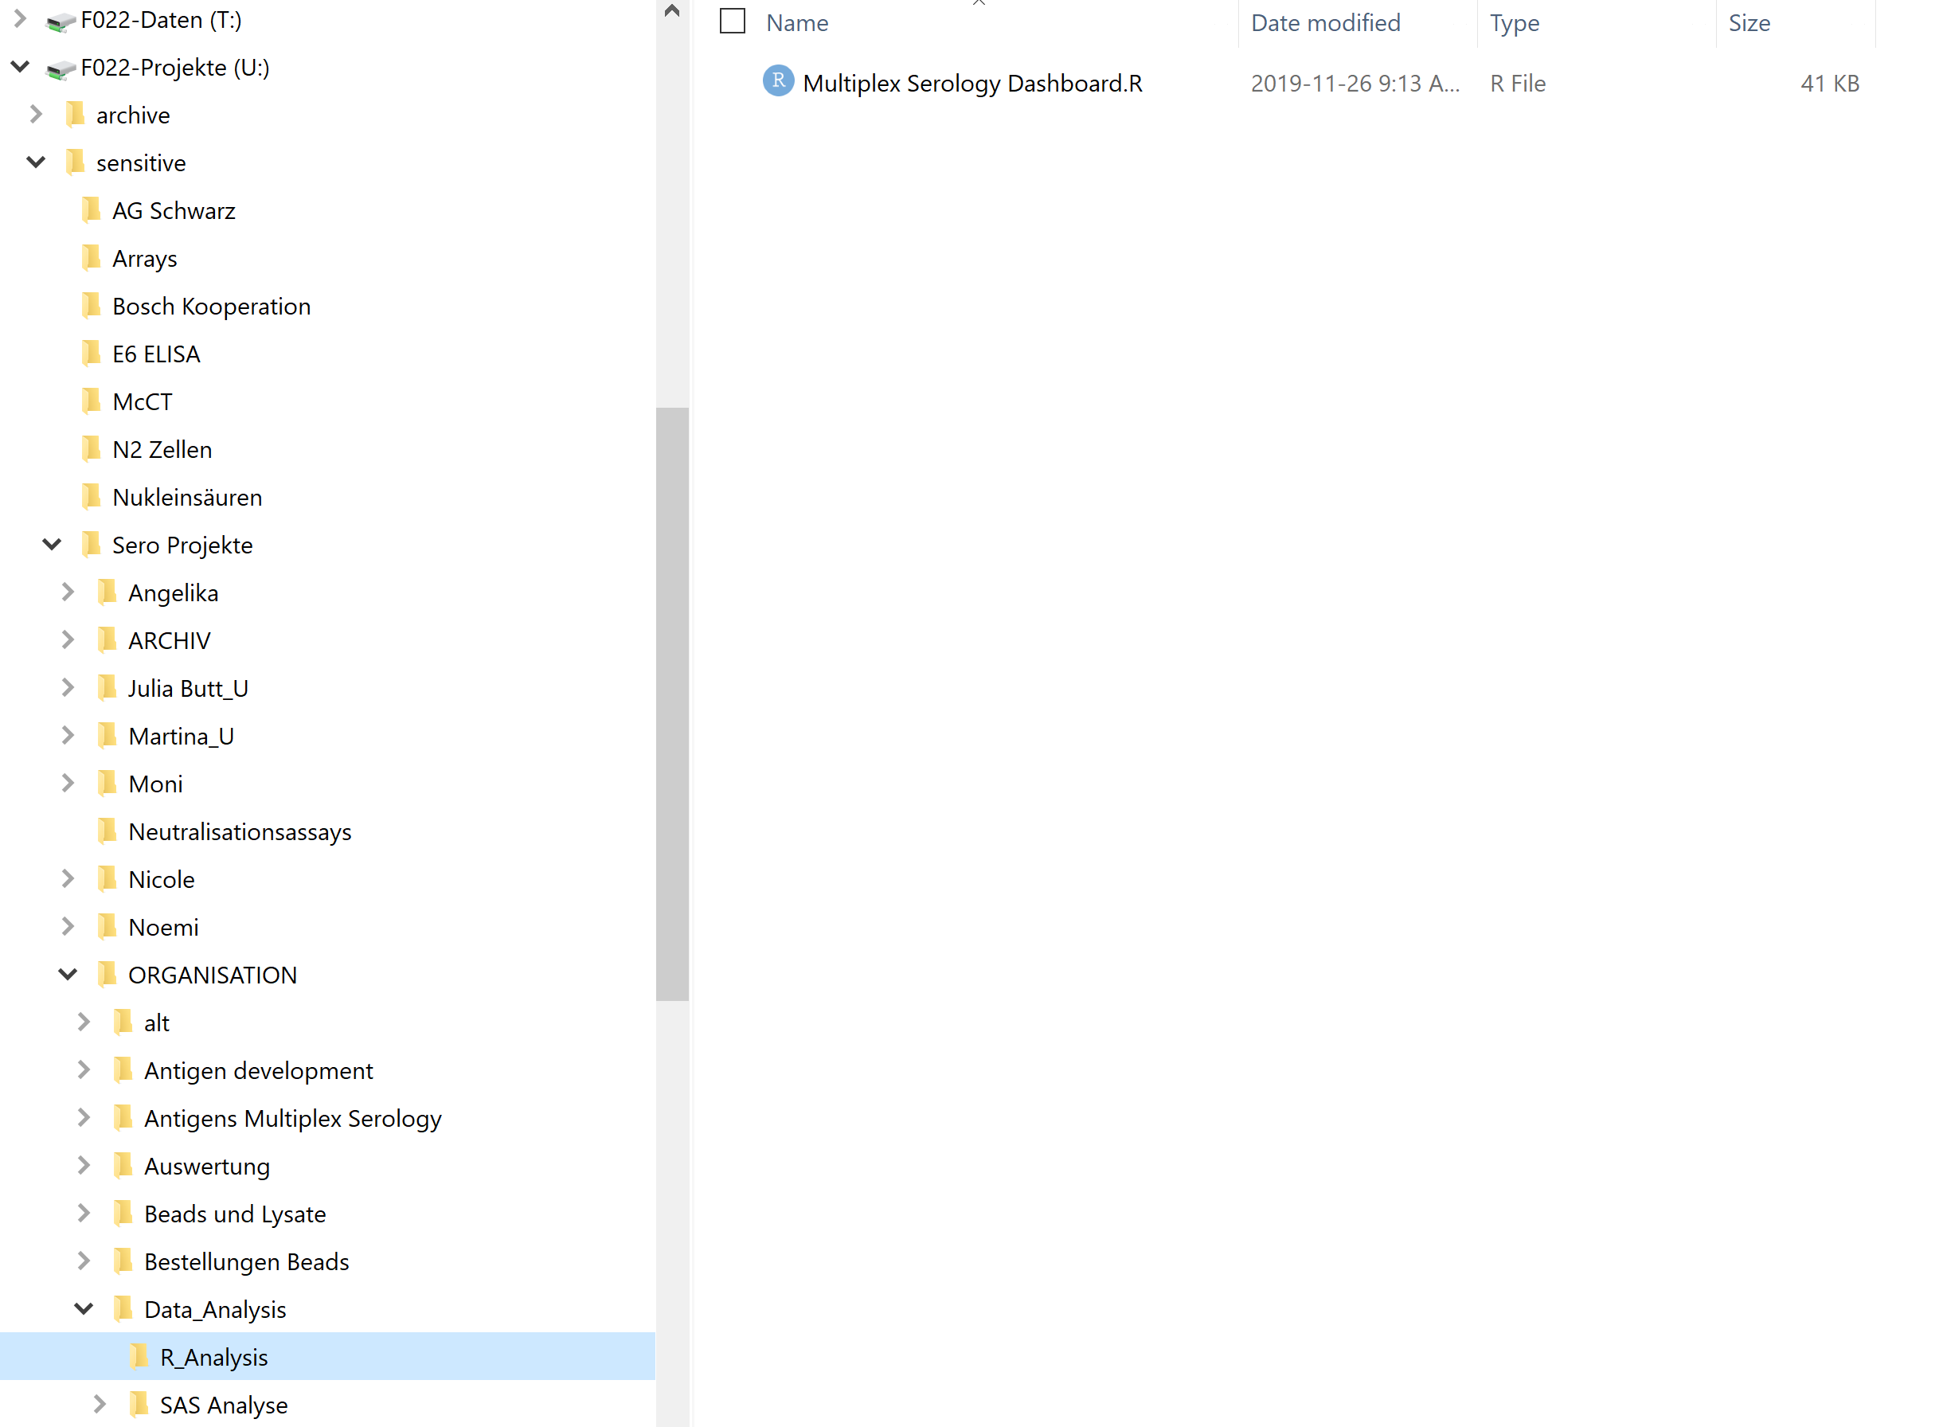
File Location
Directory: U:\sensitive\Sero Projekte\ORGANISATION\Data_Analysis\R_Analysis

Slide 16
Thank you for your attention!

